Slide 1
Medical Store Management System
by Kritagya Painuly

Slide 2

INTRODUCTION
Medical Shop Management System is a project developed for medical shops. This system is a field concerned with purchasing and selling medicines, maintaining their inventory, generating sales invoices and generating reminders of expiry dates about medicines. It requires more time and effort when all procedures are performed manually. Thus, to reduce time consumption and human effort the Medical Shop Management System application can be applied in medicals where a manual procedure exists. The purpose of this project is to reduce time consumption and human effort. This application provides user-friendly interface as well

Slide 3




Our Services
Adding Items to Stocks.
Adding/Deleting Stocks.
Purchasing Medicines.
Listing Stocks Available
Searching a particular medicine.

Slide 4

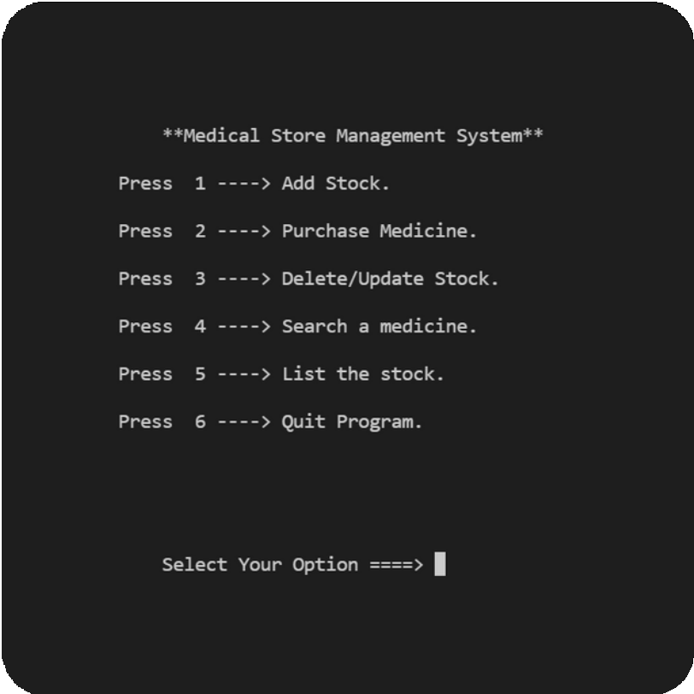
ADMIN
Medical Store Management System
LOGIN
Add Medicine
Delete/ Add Stock
Purchase Medicines
Search Medicine
List Stock

Slide 5

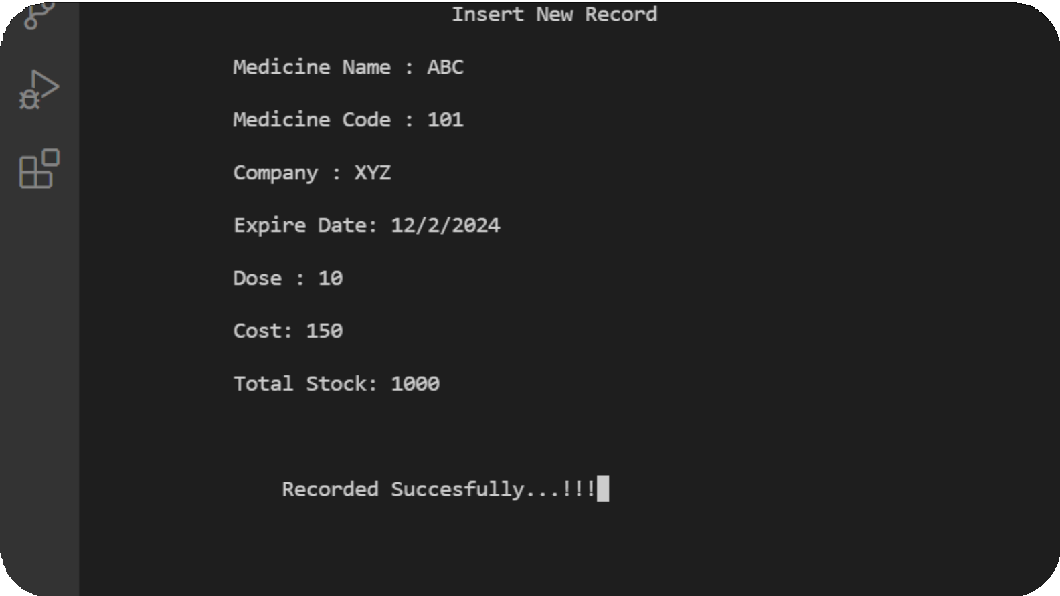
Adding Process:
Medicine Name
Medicine Code
Company Name
Date of Expiry
Dose
Cost
Total Stock

Slide 6

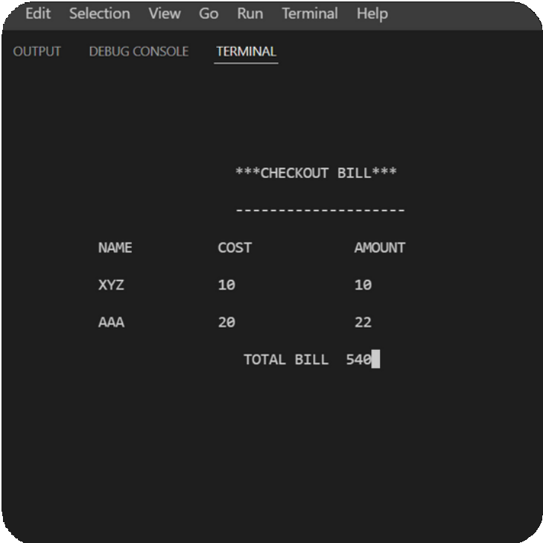
Purchasing Medicine:
Admin can simply type required medicines with number of doses to get required bill.

Slide 7
Searching Medicine:
Listing Available Stocks:

Slide 8
TECHNOLOGY OVERVIEW
HARDWARE REQUIREMENT: DEVELOPERS:
PROCESSOR: 2.0 GHZ AND ABOVE.
MEMORY: 2 GB RAM.
HARD DISK: 80 GB HDD.
USER:
PROCESSOR: 2.0 GHz AND ABOVE
MEMORY: 2 GB RAM
HARD DISK: 80 GB HDD
2.2 Technology used:
C++ Language
2.3 SOFTWARE REQUIREMENTS:
USERS: VISUAL STUDIO CODE (CROSS-PLATFORM)

Slide 9
Language Used:
C++
Header File Used:
#include<iostream> #include<conio.h> #include<windows.h> #include<iomanip>
Function Used:
void gotoXY(int,int); void Cdelay(int);
void border(int, int,int, int);
void loginFrame(int, int, int, int);
void editstock(int,char);
void bill(int[][2],int,int); void purchase();
void update(); void intro(); void login(); void menu(); void insert();
void getrecords(); bool isFilePresent();

Slide 10
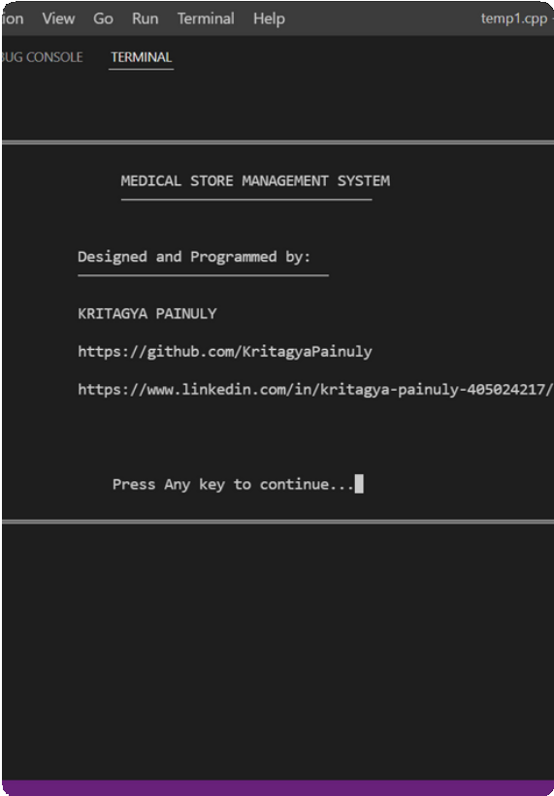
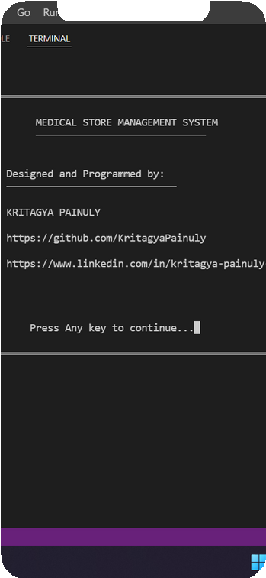
THANKYOU
Kritagya Painuly Section L
Roll no 25
Student Id 20011216

